Slide 1
IR A + Infinitivo
In English when we want to talk about the near future we use:
Present tense of verb “TO BE” + “going to” + infinitive
Ex: I am going to dance.
In Spanish we use IR + A + INFINITIVO

Slide 2
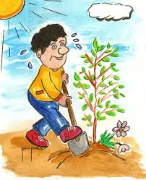
I am going to work in the garden.
Voy a trabajar en el jardín.

Slide 3
IR | To GO
voy | vamos
vas | vais
va | van
A + INFINITIVO

Slide 4
We are going to prepare the food.
Are you going to vacuum?
She is going to set the table.
He is going to take out the trash.
My sister is going to pick up her room.

Slide 5
His father is going to mow the lawn.
My brothers are going to decorate the living room for the party.
Sra. Slais is going to go sailing this weekend.
The boys are going to make the bed.

Slide 6
My sister is going to clean the bathroom this afternoon.
They are going to put the dessert in the refrigerator.
Juan and I are going to wash the dishes tonight.
My best friend is going to get to know downtown on Saturday.
The teacher is going to visit the museum on Sunday.

