Slide 1
Vocabulario 1
español 2- capítulo 6

Slide 2

fascinar
to love

Slide 3
fastidiar
to bother

Slide 4
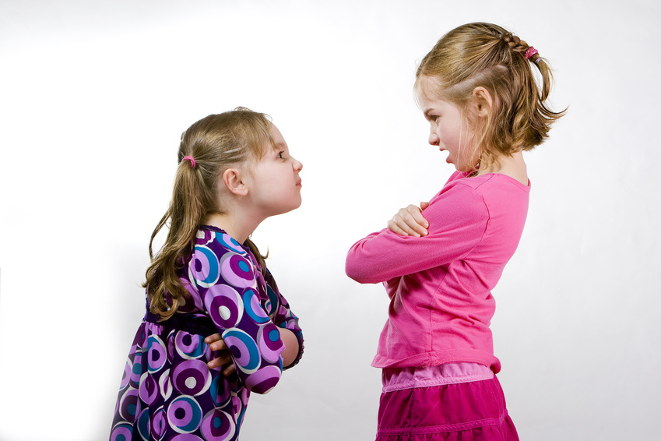
molestar
to bother

Slide 5

odiar
to hate

Slide 6
pelearse
to fight

Slide 7
llevarse bien/llevarse mal
to get along well/badly

Slide 8
contar chistes/cuentos/ chisme
to tell jokes/stories / gossip

Slide 9
echar carreras
to run races

Slide 10
columpiarse
to swing

Slide 11
compartir los juguetes
to share toys

Slide 12
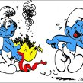
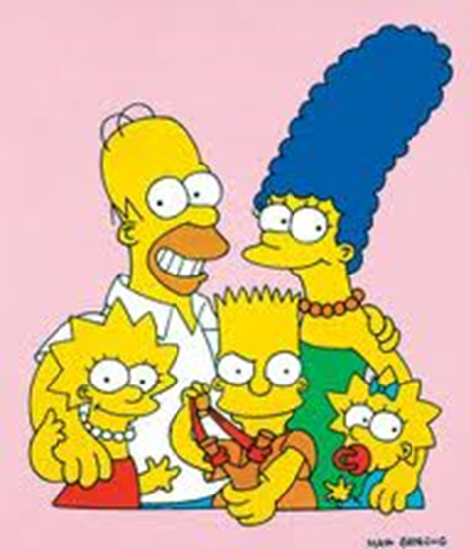
hacer travesuras
to play tricks

Slide 13
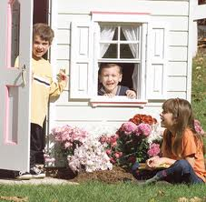
jugar a la casita
to play house

Slide 14
jugar a las damas
to play checkers

Slide 15
jugar al escondite
to play hide and seek

Slide 16
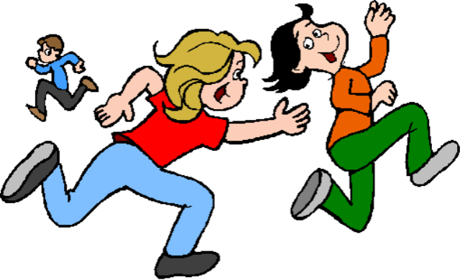
jugar al pilla-pilla
to play tag

Slide 17
jugar con bloques
to play with blocks

Slide 18
jugar con carritos
to play with cars

Slide 19
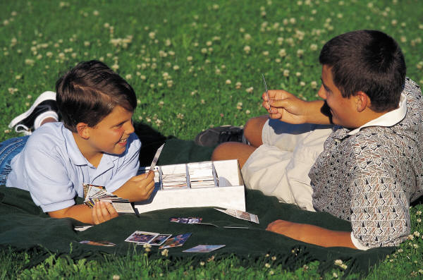
Jugar con las láminas
to play with trading cards

Slide 20
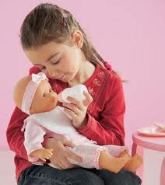
Jugar con las muñecas
to play with dolls

Slide 21
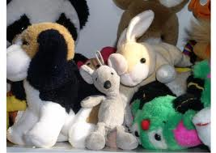
Jugar con los animales de peluche
to play with stuffed animals

Slide 22
sacar buenas notas/malas notas
to get good/bad grades

Slide 23
saltar a la cuerda
to jump rope

Slide 24
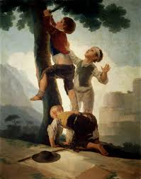
trepar a los árboles
to climb trees

Slide 25
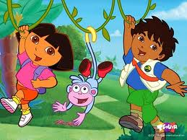
ver los dibujos animados
cartoons

Slide 26
el/la astronauta
astronaut

Slide 27
EXPRESIONES

Slide 28
Al contrario
Not at all!
On the contrary…

Slide 29
¿Qué te gustaba hacer cuando tenías...años?
What did you like to do when you were ___ years old?

Slide 30
Answers….
Cuando tenía _#_ años me gustaba +infinitivo
  When I was ___ years old I used to like infinitive
De pequeño(a) me gustaba + infinitivo
  When I was little I used to like infinitive

Slide 31
Answers continued…
Me fascinaba + infinitivo
  I used to love infinitive
Odiaba + infinitivo
  I used to hate infinitive
Me molestaba/fastidiaba + infinitivo
  It used to bother me infinitive

Slide 32
¿Te llevabas bien con tus hermanos?
Did you get along well with your siblings?

Slide 33
Answers…
Nos llevábamos bien
  We used to get along well
Me fastidiaba estar con ellos
  It bothered me to be with them.
Nos peleábamos todos los días
  We used to fight every day.

Slide 34
¿Con qué soñabas?
What did you used to dream about being?
¿Qué querías ser?
What did you used to want to be?

Slide 35
Answers…
Soñaba con ser +profession
  I used to dream of being a profession
De pequeño(a) quería ser + profession
  When I was little I used to want to be a profession

Slide 36
¿Qué hacías de niño(a)?
What did you used to do when you were a little boy/girl?

Slide 37
Answers…
Solía + infintive
  I used to infinitive
Solíamos + infintive
  We used to infinitive
De niño(a)…
  As a little boy/girl…

Slide 38
Verbs like ‘gustar’

Slide 39
To talk about what you used to like and dislike
¿Qué te gustaba hacer cuando tenías … años? What did you like to do when you were … years old? | Cundo tenía… años (de pequeño/a) me gustaba echar carreras When I was… years old (when I was young) I used to like…
De pequeño(a), ¿te llevabas bien con tus hermanos? When you were little, did you get along well with your brothers and sisters? | ¡Al contrario! Me fastidiaba estar con ellos. Nos peleábamos todos los días. Not at all! As a matter of fact, it bothered me to be with them. We fought every day.

Slide 40
To talk about what you used to do and what you wanted to be
¿Qué hacías de niño(a)? What did you use to do when you were a little boy (girl)? | [De niño(a)?]Solía jugar al pilla-pilla [When I was a little boy/girl] I used to play tag..
¿Qué querías ser? ¿Con qué soñabas? What did you want to be? What did you dream of (being when you grew up)? | Soñaba con ser… Quería ser… I dreamed of being… I wanted to be…

